Slide 1


Digital Freelancer:
Managing Freelancing Projects
Project: Working with a Mock Client

Slide 2
Part 1
Project Listing

Slide 3
Sample Project Listing #1: Web Development
Web application development support needed for healthcare application.
Posted 2 hours ago
Hourly: $35.00 - $65.00 Based on experience.
Project Time: 3 months, 25 hours a week.
Project Description:
We are a web development company working with a healthcare client looking to connect patients directly with their doctors. We need someone to be able to take PSD mockup files from our designer and convert them into custom code using HTML, CSS, and JavaScript. We have not decided on which JavaScript library to use, but will be open to working with the one you’re most familiar with. We have the designs for 10 pages and will need them to be completed in 3 months. We are open to working with all levels of experience, but the pay will be adjusted based on your experience.

Slide 4
Sample Project Listing #2:
Digital Marketing
Email Marketer for Annual Fundraising Event.
Posted 2 days ago
Hourly: $30.00 - $40.00.
Project Time: 1 month, 10 - 15 hours a week.
Project Description:
We are looking for someone to create a drip email campaign to help us sell tickets for our annual fundraising event for our non-profit. This would require audience segmentation, custom email creation, and call-to-action development. We are to reach our goal of 700 tickets sold. We haven’t decided on the best tool to do this yet and would be open to your recommendations. Serious inquiries only.

Slide 5
Sample Project Listing #3: Data Analyst
Seeking experienced Data Analyst to build dashboard for local insurance company.
Posted 1 week ago
Hourly: $90.00 Based on experience.
Project Time: 1 year, 20 hours a week.
Project Description:
I have taken over a local car insurance company from my parents and have inherited hundreds of Excel spreadsheets with past and current customer information. I need help organizing this data and creating a dashboard to allow me to filter the data and create reports as needed. I would also need guidance on how to transfer the data to the tool of your choice. Looking forward to working together!

Slide 6
Part 2
Expression of Interest

Slide 7
Expression of Interest
Write an initial expression of interest (EoI) to the client:
Now that you’ve understood what the client is asking for, it’s time for you to reach out to them.
Write out an EoI message addressing their requirements as well as how you can help them.
This message will be their first impression of how you communicate with them, so it is good to be professional.
Please keep word limit between 200 - 300 words.

Slide 8
Expression of Interest (Provided)
Which Sample Project Listing did you select to respond to?
Answer:
Web Development
Please type your initial response to the client below. This should be between 200 - 300 words.
Expression of Interest:
Hey Mr. John, hope you’re doing well. I have read your project requirements and I think I have the capabilities of making a withstanding website for connecting doctors directly with clients. I have searched about your company to get to know more about the type of business you do and I know exactly what you need for the PSD mockup. I will be using HTML with CSS as required, but for JavaScript Library, I recommend using Vue js for its Customizability, Flexibility, Integrability, and Lightweight which will help in finishing up the work fast with a pleasant user interface, using Vue Js can reduce the total time by 20% compared to other alternative available tools, and it’s free. add to that I am so familiar with that tool as I worked with that tool for over 250 hours, it’s full of amazing features like harmonic animations. I am specialized as a front-end web developer for a year right now, so I know exactly how to use the tools to make the PSD mockup perfectly. I have been part of a great team in a company that made over 100 amazing websites over the past year only for different clients all over the world. So, I know how to get the job done both fast and efficiently. I can guarantee you that I have a full awareness of how critical this job is and that anything that can go wrong may lead to some human disasters. I am free to work 25 hours per week for the next 3 months as you mentioned in the project requirements. You can see my previous projects from my portfolio to see how I am serious with the projects I do. So, I can do this project for 45$ per hour based on my previous projects and my experience.
Hope you contact me, have a great day Mr. John.

Slide 9
Part 3
Project Management Process

Slide 10
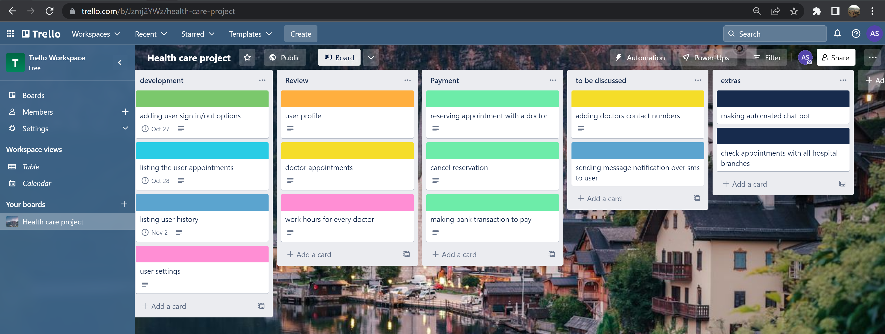
Trello Board
Please include the following information for your Trello board:
A link to your public Trello board should be provided here:
https://trello.com/b/Jzmj2YWz/health-care-project
Include a screenshot of the board below:
Paste screenshot here

Slide 11
Part 4
Invoice and Payment Options

Slide 12
Dummy Company 25 el haram street / Giza governorate / Egypt
Invoice
Recipient:
John holmes
23 baker st / Newyork city / united states of america
Invoice #: 456126421
Date issued: 18/12/2022
Date due: 30/12/2022
Services Rendered (Continue on next page)
Service | Description of Work Done | Hours Spent | Amount Per Hour | Total
adding user sign in/out options | this process of making user sign in options like signing in with google/facebook or just using his normal account and also to sign out | [Amount of hours spent on service] | 45$ | 3 x 45 = 135$
listing the user appointments | this is the feature of listing all user reserved upcoming appointments and the appointments that he done with the doctors | [Amount of hours spent on service] | 45$ | 2 x 45 = 90$
listing user history | see all previous previous prescription that was given by old appointments with the doctors | [Amount of hours spent on service] | 45$ | 5 x 45 = 225$
user settings | change the way of the interface looks like, change email account, change username, password, etc... | [Amount of hours spent on service] | 45$ | 1.5 x 45 = 67.5$

Slide 13
Dummy Company 25 el haram street / Giza governorate / Egypt
Invoice
Services Rendered (continued)
Service | Description of Work Done | Hours Spent | Amount Per Hour | Total
user profile | see all things related to user profile like favorite doctors , diseases that he have and so on | [Amount of hours spent on service] | 45$ | 2.5 x 45 = 112.5$
doctor appointments | this is the doctors side of the operation where they got to see all the appointments they have with their patients and some information about the patient | [Amount of hours spent on service] | 45$ | 3.5 x 45 = 157.5$
work hours for every doctor | see the table for the available doctors at the current week | [Amount of hours spent on service] | 45$ | 3 x 45 = 135$
reserving appointment with a doctor | making an appointment with the doctor | [Amount of hours spent on service] | 45$ | 1 x 45 = 45$

Slide 14
Dummy Company 25 el haram street / Giza governorate / Egypt
Invoice
Services Rendered (continued)
Service | Description of Work Done | Hours Spent | Amount Per Hour | Total
cancel reservation | cancel appointment with the doctor | [Amount of hours spent on service] | 45$ | 1 x 45 = 45$
making bank transaction to pay | pay when making an appointment | [Amount of hours spent on service] | 45$ | 1.5 x 45 = 67.5$
adding doctors contact numbers | just adding contact numbers for doctors in case of emmergency | [Amount of hours spent on service] | 45$ | 0.5 x 45 = 22.5$
sending message notification over sms to user | send SMS message to the user in case that he is offline to notify him with important update | [Amount of hours spent on service] | 45$ | 4 x 45 = 180$
The total amount of hours: 28.5
Total Payment Due: 1282.5$
Payment Options:
Paypal: dummyAccount@gmail.com

